Slide 1

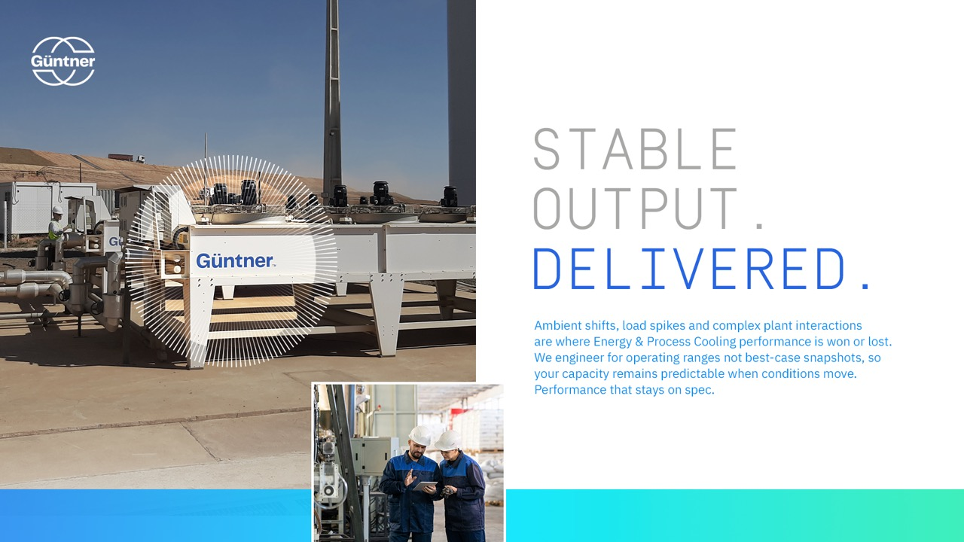

TITLE SLIDE TO GO HERE.
Subtitle text or intro copy
Notes:
Title Slide

Slide 2

OR
HERE.
Industrial cooling decisions carry long-term operational responsibility for heat load, process stability, and system efficiency. Güntner helps engineers get these decisions right from the start.

Slide 3
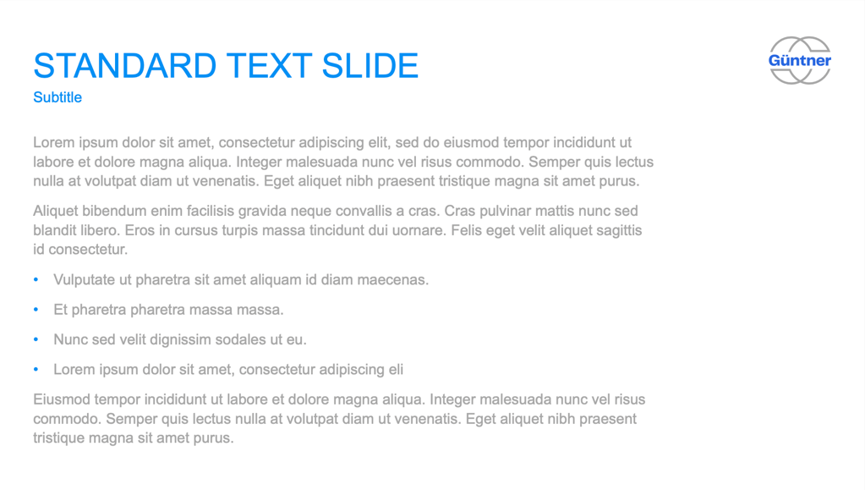


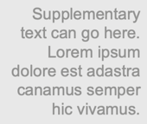


Slide 4

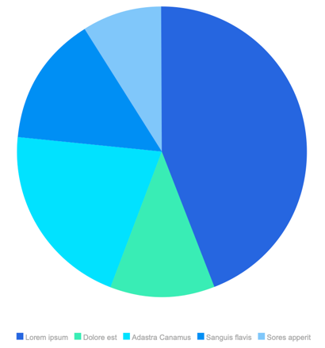
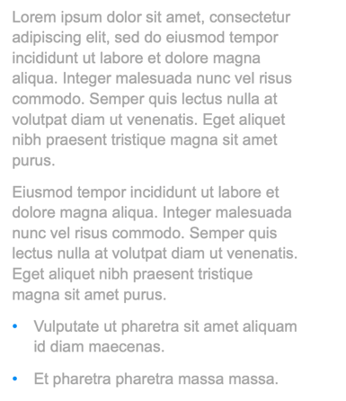


Slide 5

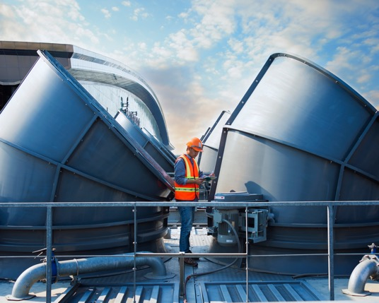



Slide 6




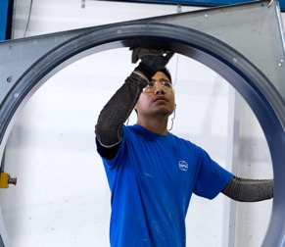

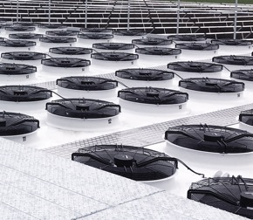


Slide 7





DIVIDER SLIDE

Slide 8


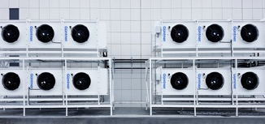
DIVIDER SLIDE

Slide 9

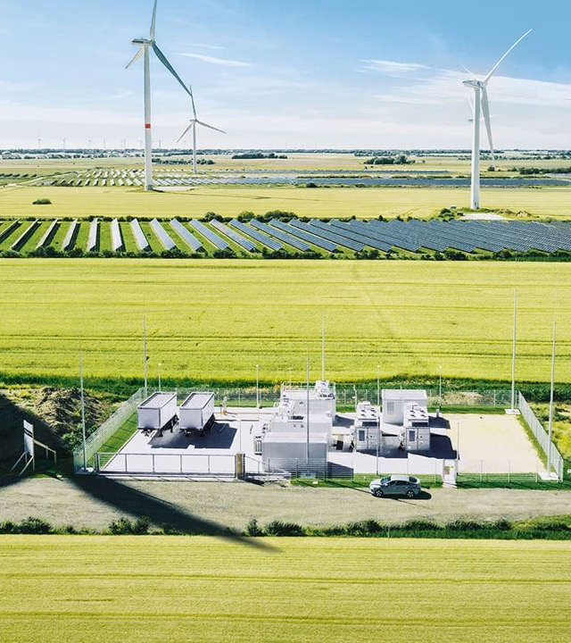
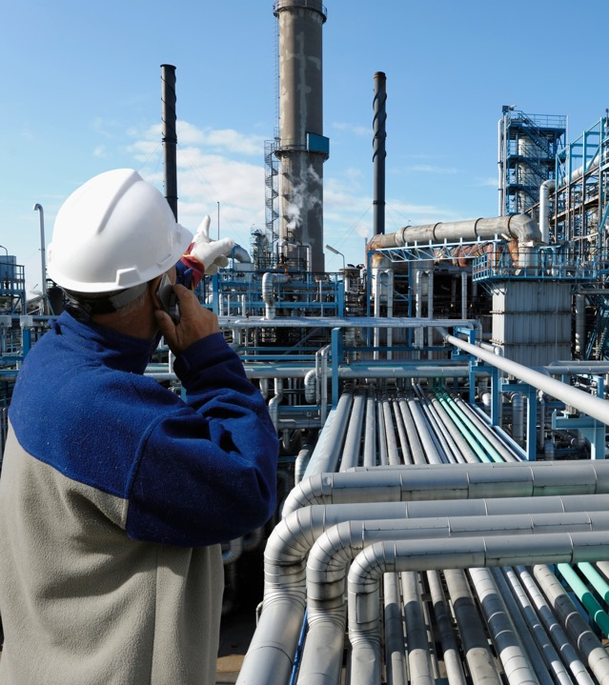


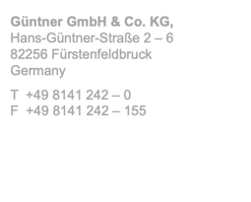
THANK YOU.

